Slide 1
RDP – Round 2
RD216466

Slide 2
Main Approach:
Take data from IRINS dataset and optimize for better querying
Arch diagram
Unique Value Proposition:
Useful analysis and filtering tools.
Efficient and accurate results
authentic records, genuine people
No cap for max
Data from source no manipulation, up to data
Design Choices:
Used the React JS front-end for ease of usage
Scraper that can be used to independently replenish the data
Responsive web server that can be used to perform fast operations
Monolithic arch due to time constraint
Cons: (known) limitations
Verified for Engineering and sciences
25 max
No multi level search, tried
Researchers only within India are covered due to the source of data

Slide 3
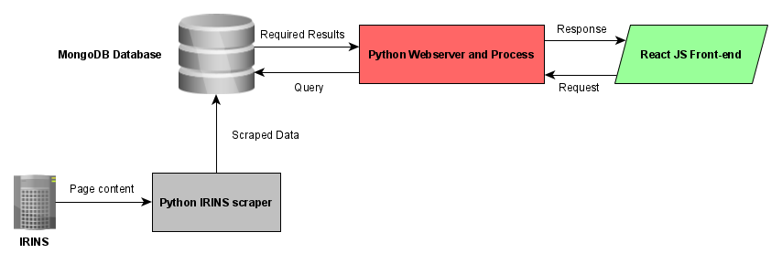
Main Approach:
Take data from IRINS dataset and optimize for better querying. Display the relevant results in an intuitive frontend.
Unique Value Proposition:
Authentic records from credible sources.
No limit regarding quantity of results.
Up-to-date data from source with no scope for bias.
Design Choices:
Monolithic design architecture has been implemented. This is due to time constraints.
Modular setup of application for ease of debugging and scaling.
Known Limitations:
Verified results for fields relating to engineering and sciences.
25 results per page of data.
Simple query comprehension.

Slide 4





Elements:
The technologies used in the tech stack.
MongoDB
Python
Scrapy
Tornado
React JS
Project Inception
Identification of Sources
Science Direct Scraper
ACM Scraper
IRINS Scraper
Flask Server
Tornado Server
React JS
Front End Integration
Intuitive UI Framework
Present Day
Inclusion of other datasets
Optimization of current scrapers
Cloud Migration
Data export

Slide 5
Features:
A filter via institution
Sorting via H-Index, Citations and Name
ORC-ID details
Direct contact Information
Qualifications of researchers
Multiple views
Element(tech stack)
Solution with the above features is ready to deploy
Challenges faced were:
Identification of a reliable dataset
Front-end Integration
Creating a simple yet effective UI
roadmap

Slide 6
Contributions:
Next steps:
Inclusion of other datasets
Optimization of existing dynamic scrapers
Data exporting capabilities
Migration to cloud env
Anirudh CP | Implementation and Testing
Dr. Rajakumar Arul | Advisor and Testing

